Slide 1
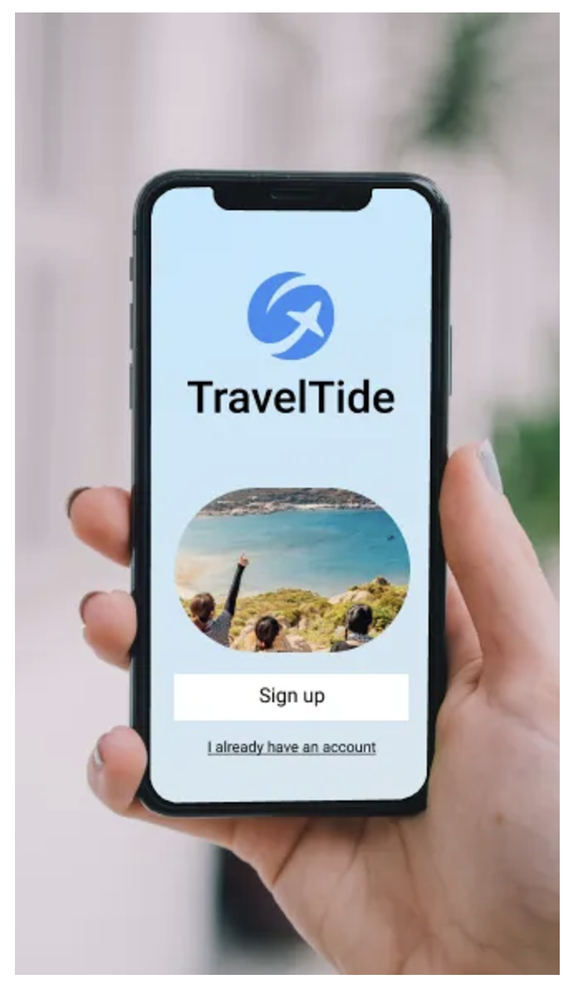
Travel Tide Project
Discovering Customer Trends: Analyzing Segments for Enhancing the Reward Program.
Diana Alejandra Terraza López

Slide 2
What is TravelTide?
An e-booking Startup, is a rising start in the online travel industry. Since its founding in April 2021, at the end of the COVID-19 pandemic, the company has seen steady growth, driven by its top-tier data aggregation and search technology.
Customer feedback has shown (and industry analysts are agreeing ) that TravelTide customers have access to the largest travel inventory in the e-booking space.

Slide 3

Objectives of this project
Conduct a thorough exploratory data analysis to uncover meaningful patterns and insights.
Extract key findings to inform decision-making.
Segment customers by analysing their booking behaviours and demographic characteristics, emphasizing those most likely to benefit from Travel Tide's proposed perks.

Slide 4
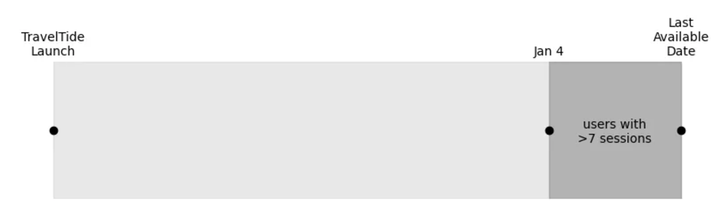
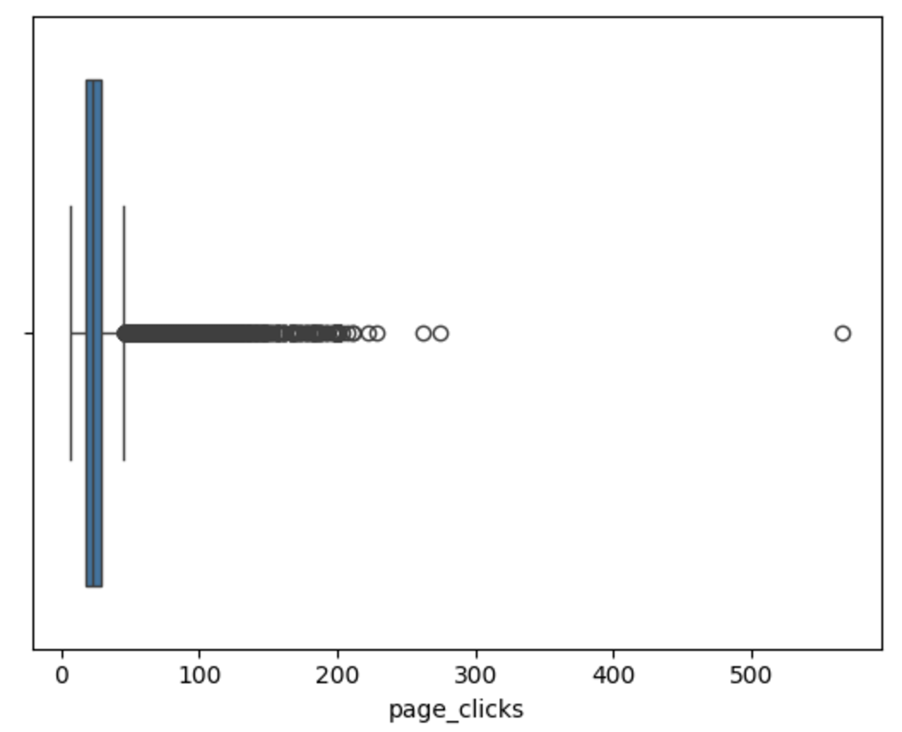
Data Preprocessing
Filtering the Data and define the Cohort
Forming the initial extraction query which can be then used for further analysis
Aggregate the data on User level: Flight, and Hotel data, preserving fields that carry demographic or behavioural data, and merge the results into a single table.
Removing Outliers: the presence of extreme values might bias our estimates of average behaviour. (page clicks)
Anomalies with the Night Column
Empty data values in the column trip id

Slide 5
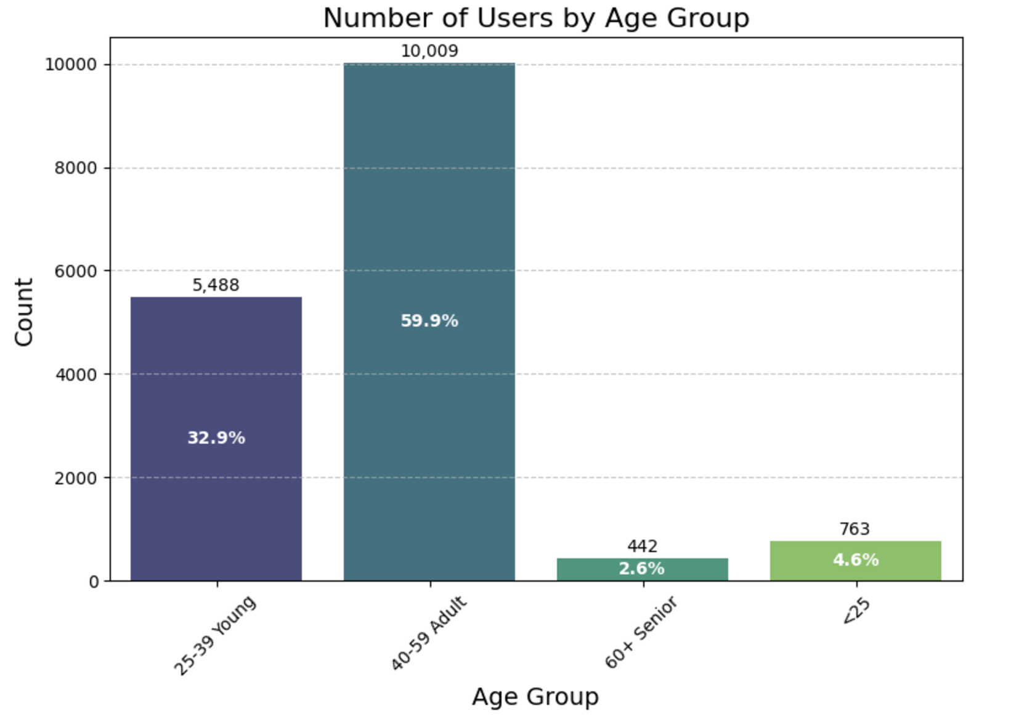

Demographic insights
Categorized users into different age groups based on the data to facilitate classification and analysis

Slide 6
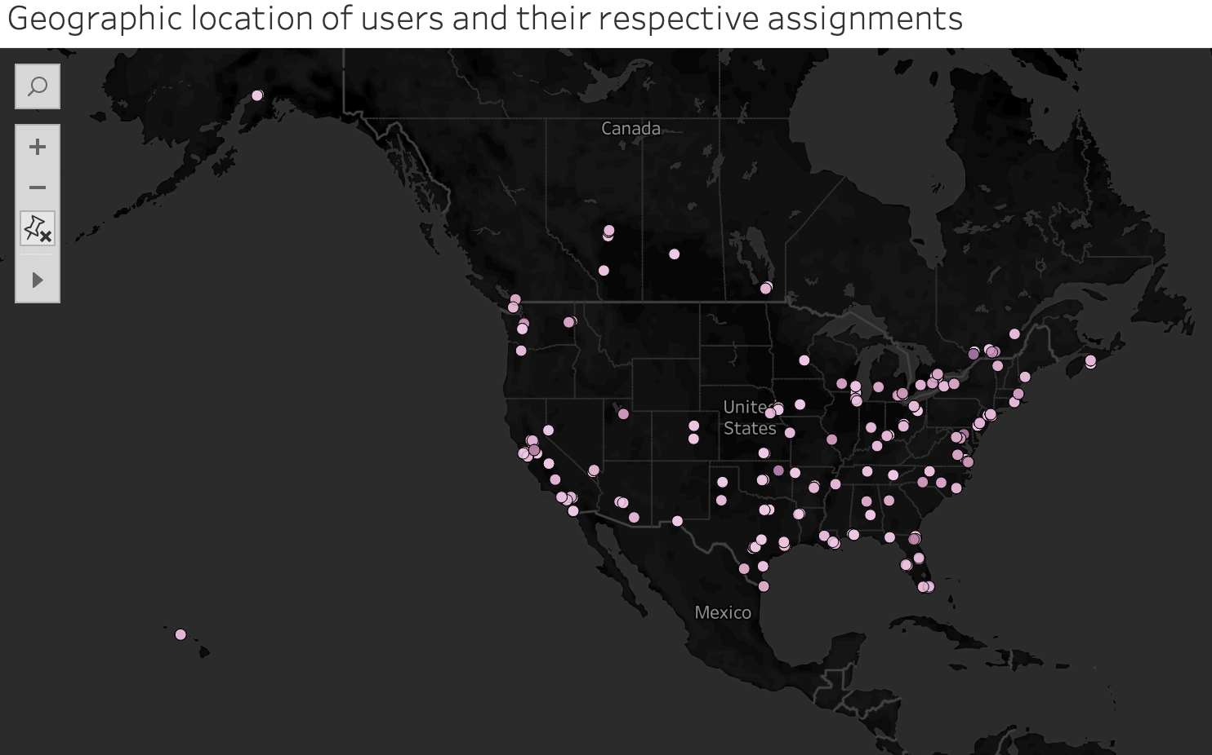
Demographic Insights

Slide 7
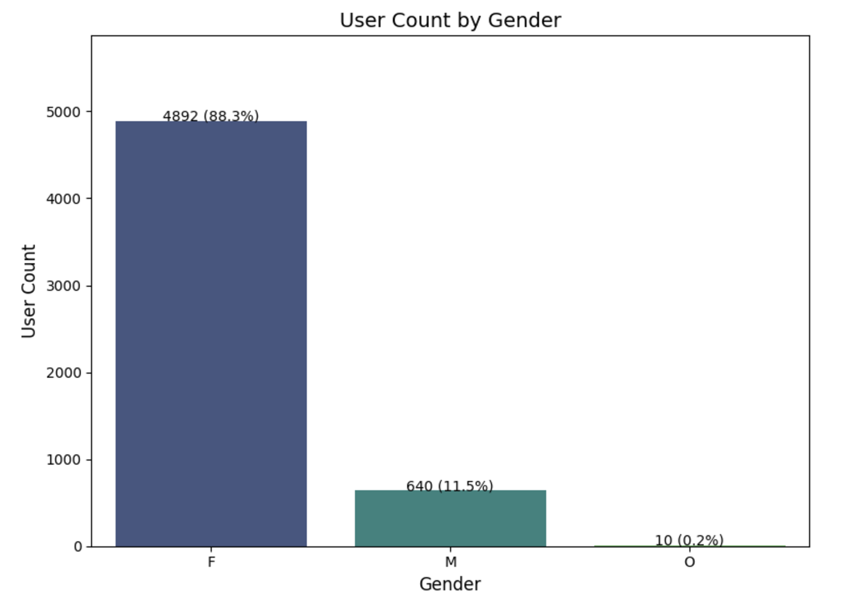

Number of Users by Gender
We can notice notably that our potential users are women.

Slide 8
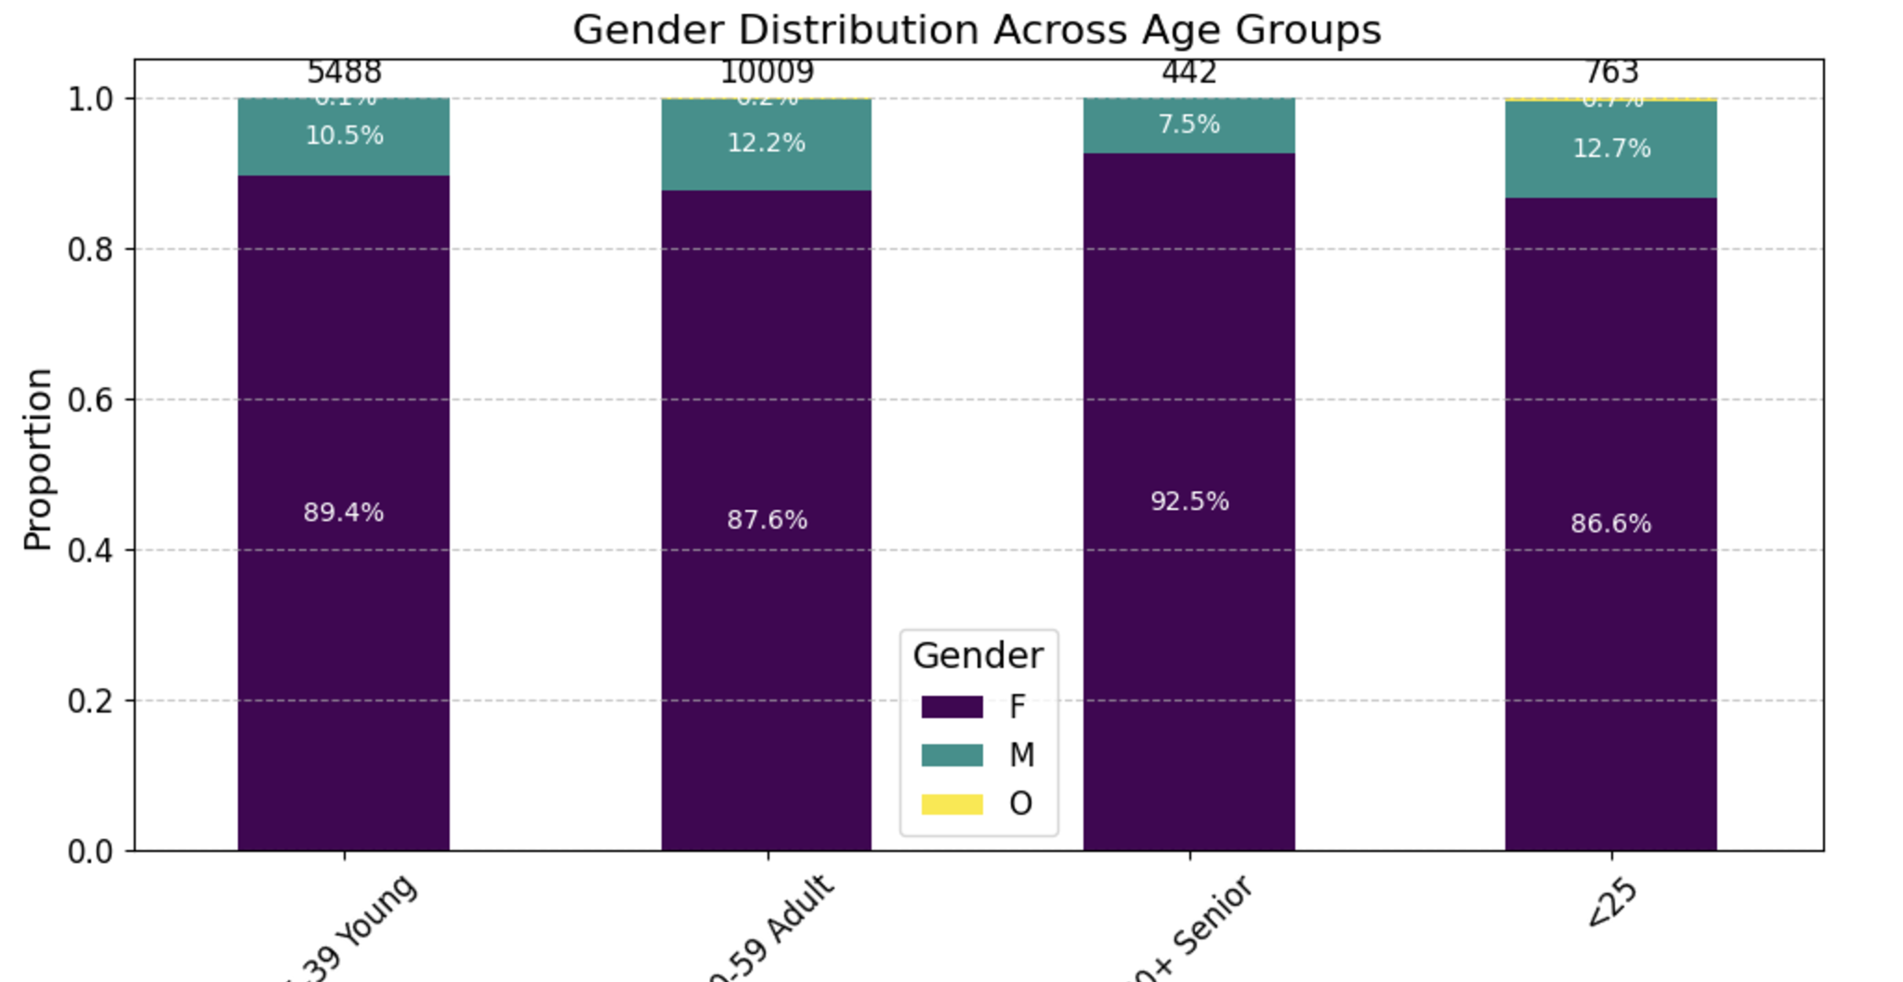

Demographic insights
A crosstab helps calculate the proportions (percentages) making it easier to understand the gender distribution relative to each age group.
Instead of just showing raw counts, a crosstab aggregates the data, providing a clearer view of how gender is distributed across different age groups.

Slide 9
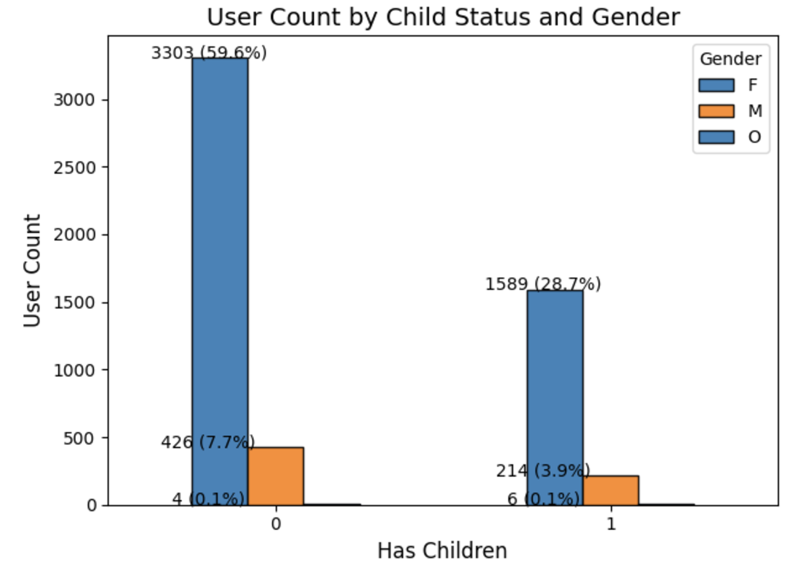
Users by Gender with Childs and without Childs
Demographic characteristics are crucial for segmentation because they provide a foundation for understanding and grouping customers based on shared traits.

Slide 10
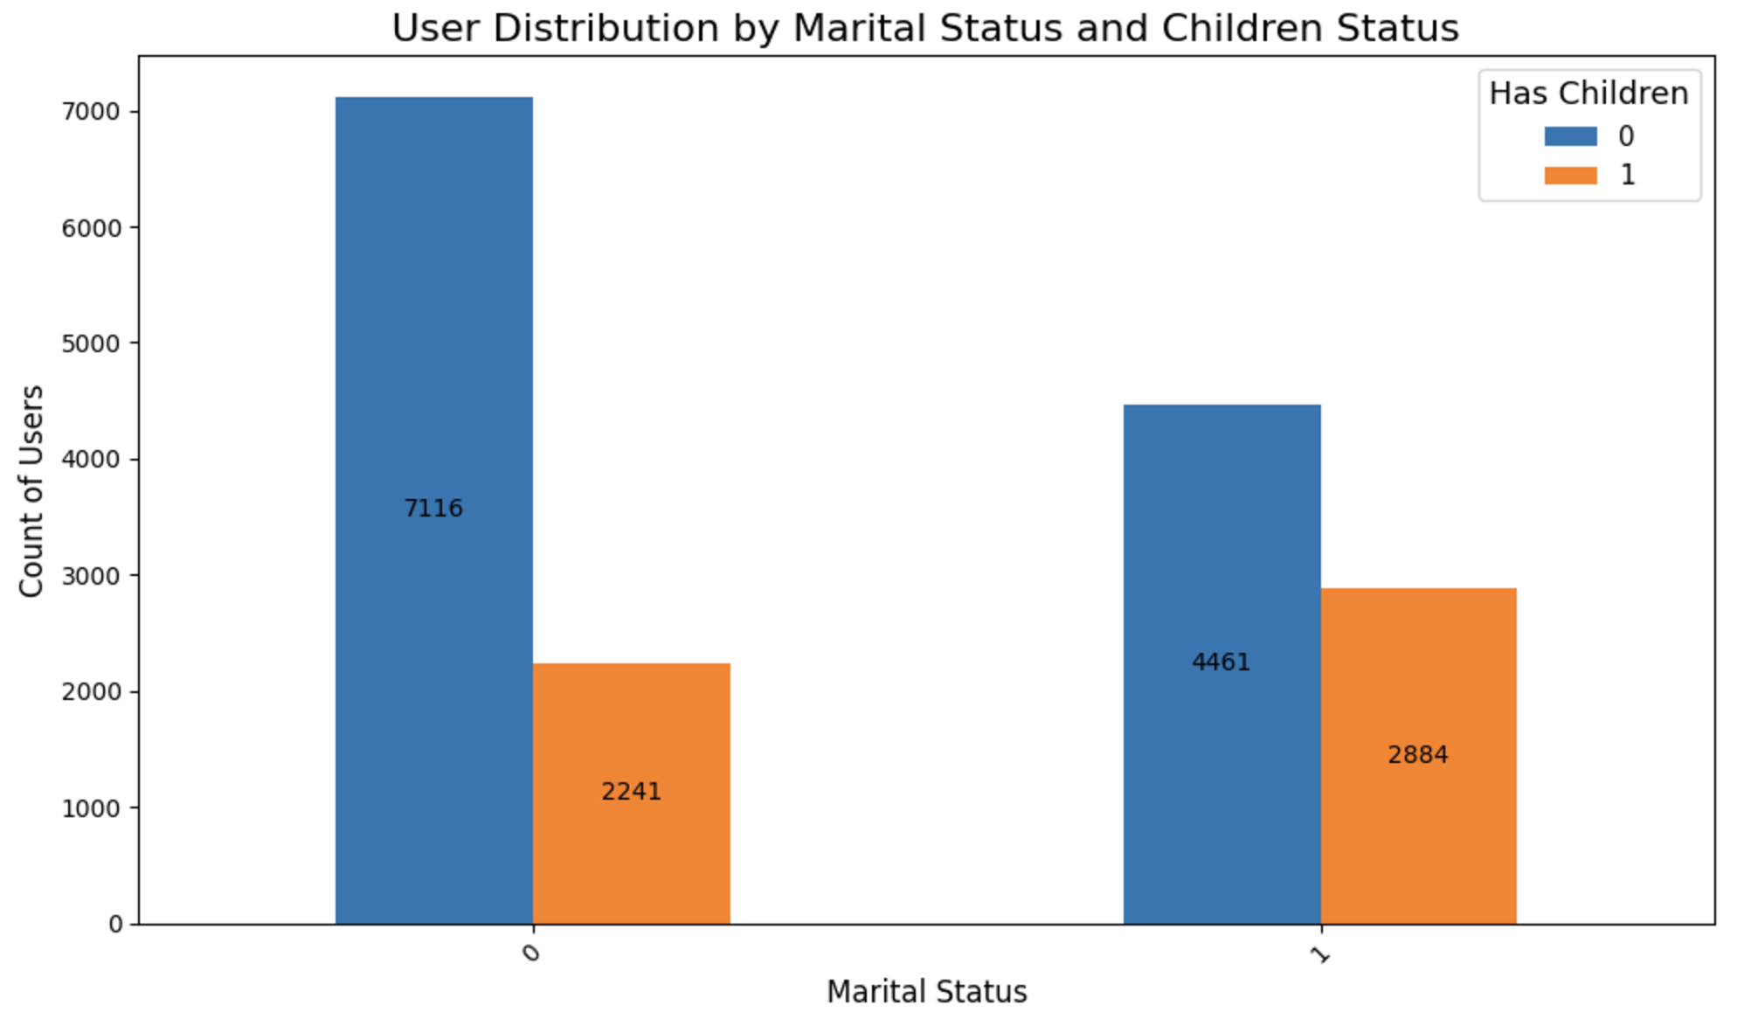
User Distribution by Marital Status and Kids

Slide 11
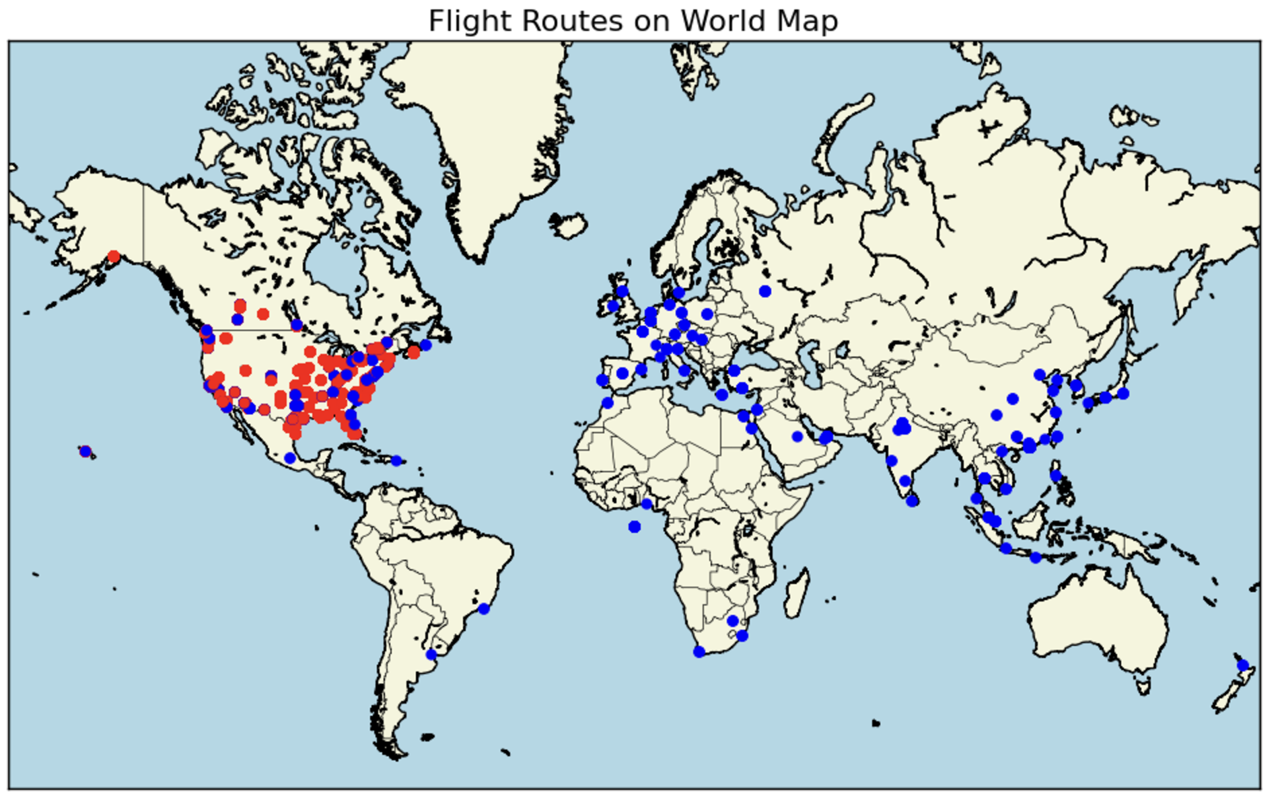
Map
Red Points for Home Airport
Blue Points for Destination Airport

Slide 12
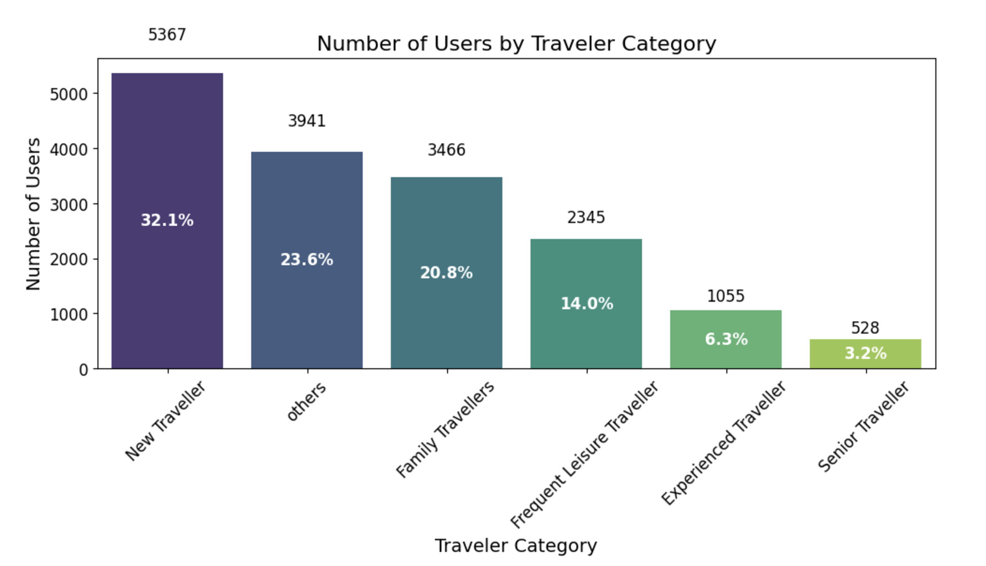
Users by Travel Category
After establishing age ranges, I grouped users into travel categories based on their behaviour and key demographic characteristics.

Slide 13
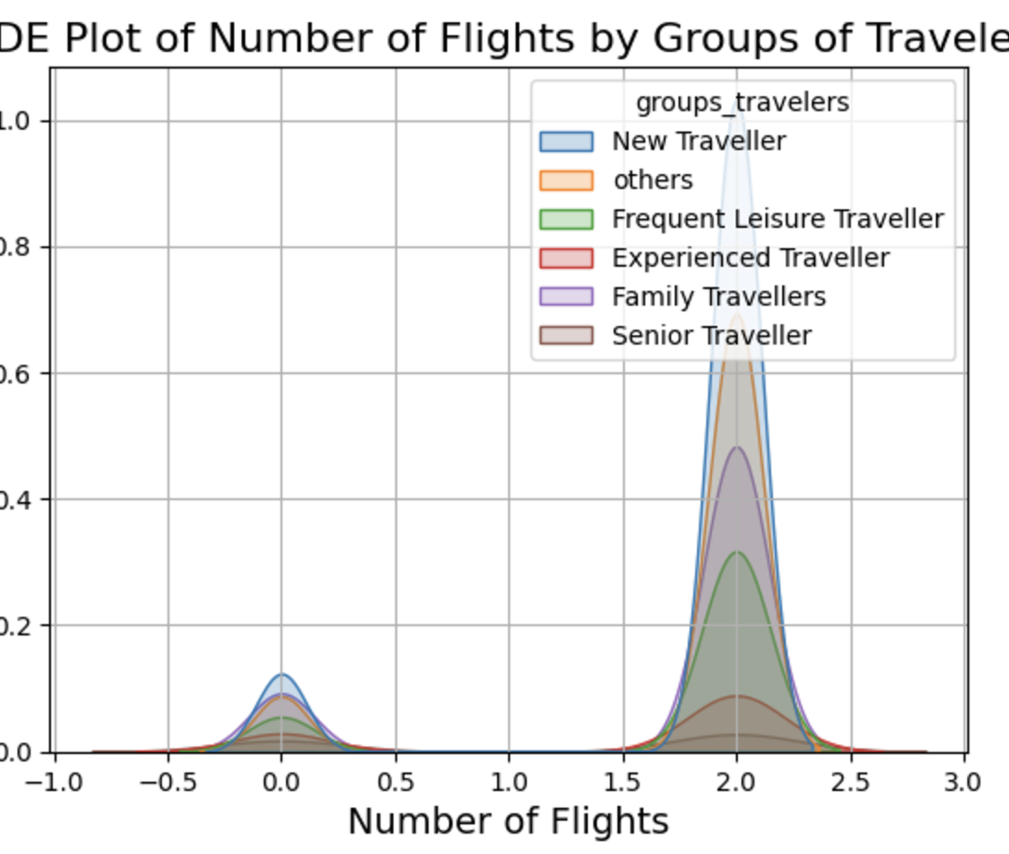
Distribution of Group Travelers
By using Kernel Density Estimation (KDE) We can observe the distribution of each group of clients in relation to their number of trips.
KDE is a great tool for visualizing the distribution of trips across groups because it offers a smooth and detailed view of the data. It helps identify patterns and differences between groups without assuming any specific distribution type.

Slide 14
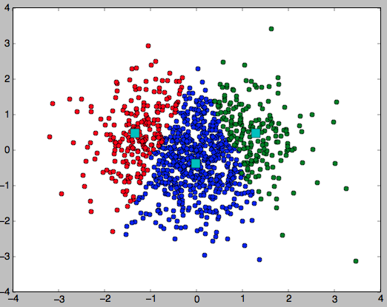
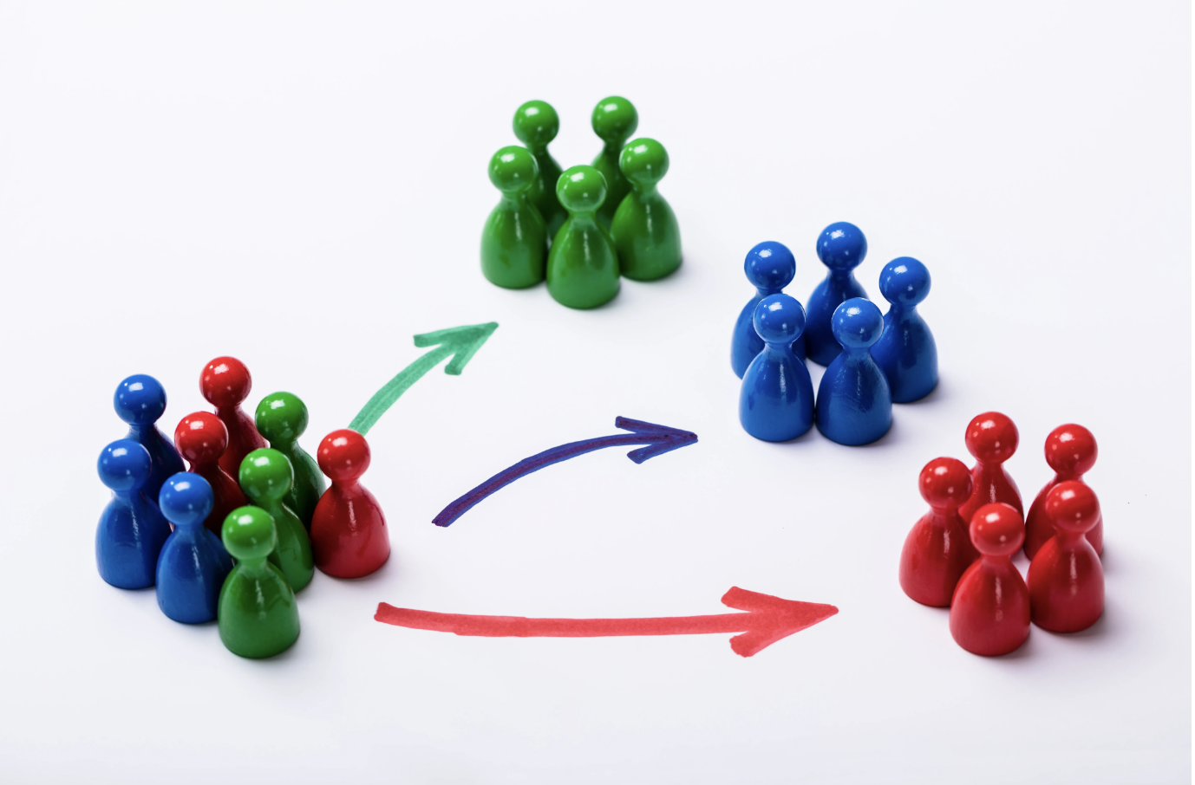
Segmenting the Users
Perks:
One Night Free Hotel With Flight
Free Hotel Meal
Free Cancellation
Free Checked Bag
Exclusive Discounts
Strategy:
Using the KMeans Algorithm, group or segment unique users into clusters based on their behaviours and preferences.
This Photo by Unknown Author is licensed under CC BY-SA

Slide 15
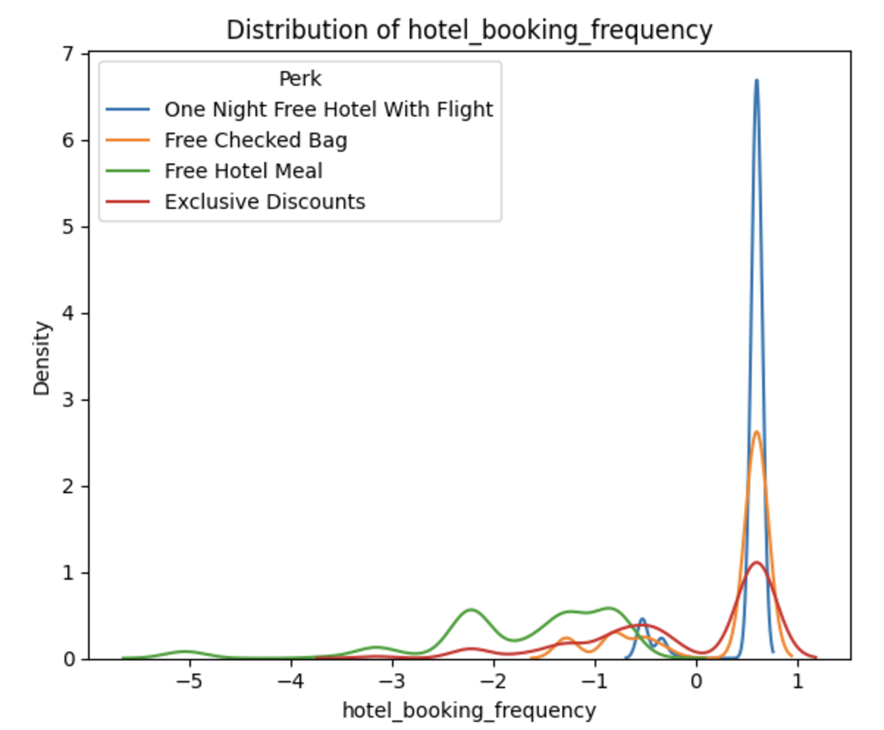
Findings and Discussion
The line chart illustrates the relationship between hotel booking frequency and checked bag usage across different customer clusters.
The 'Exclusive Discount' cluster shows the broadest range of behaviors, highlighting its strong appeal and popularity among users.

Slide 16
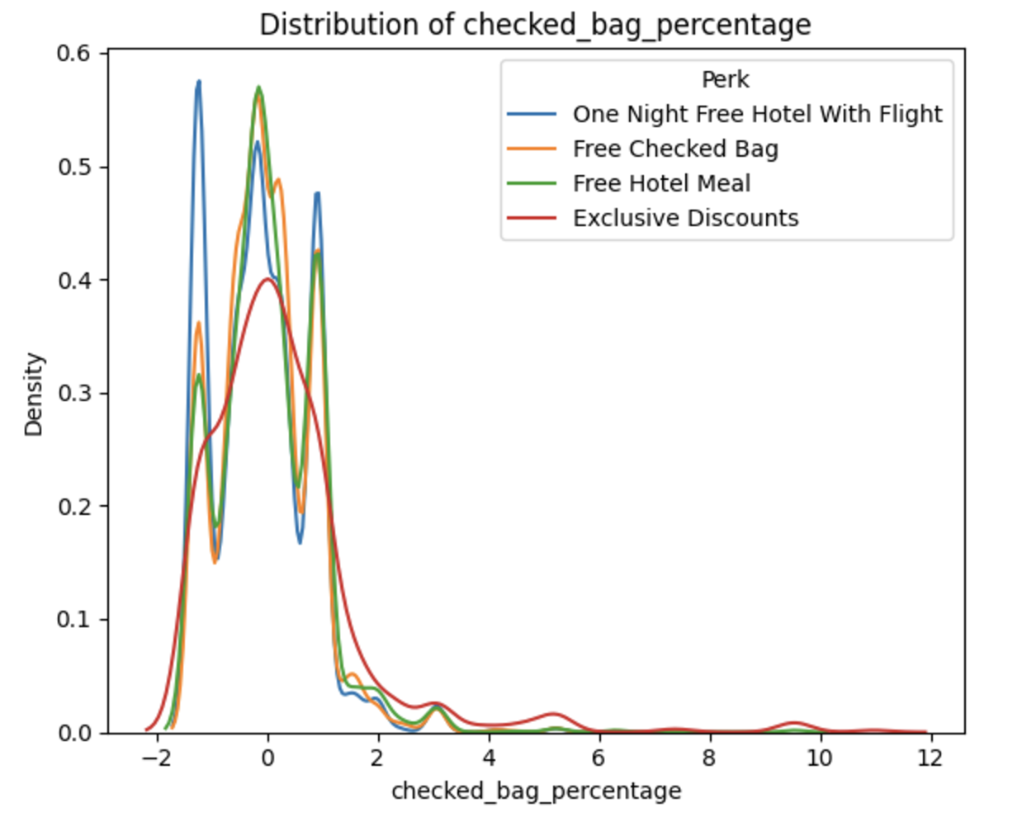
Findings and Discussion
The chart also reveals a notable overlap between clusters, suggesting that while there are distinct preferences, a significant number of users are interested in multiple perks.
This overlap indicates shared interests among the groups despite some differences in their primary preferences.
This revision clarifies the points about cluster overlap, customer behavior, and the popularity of the "Exclusive Discount" cluster, making the explanation more cohesive.

Slide 17
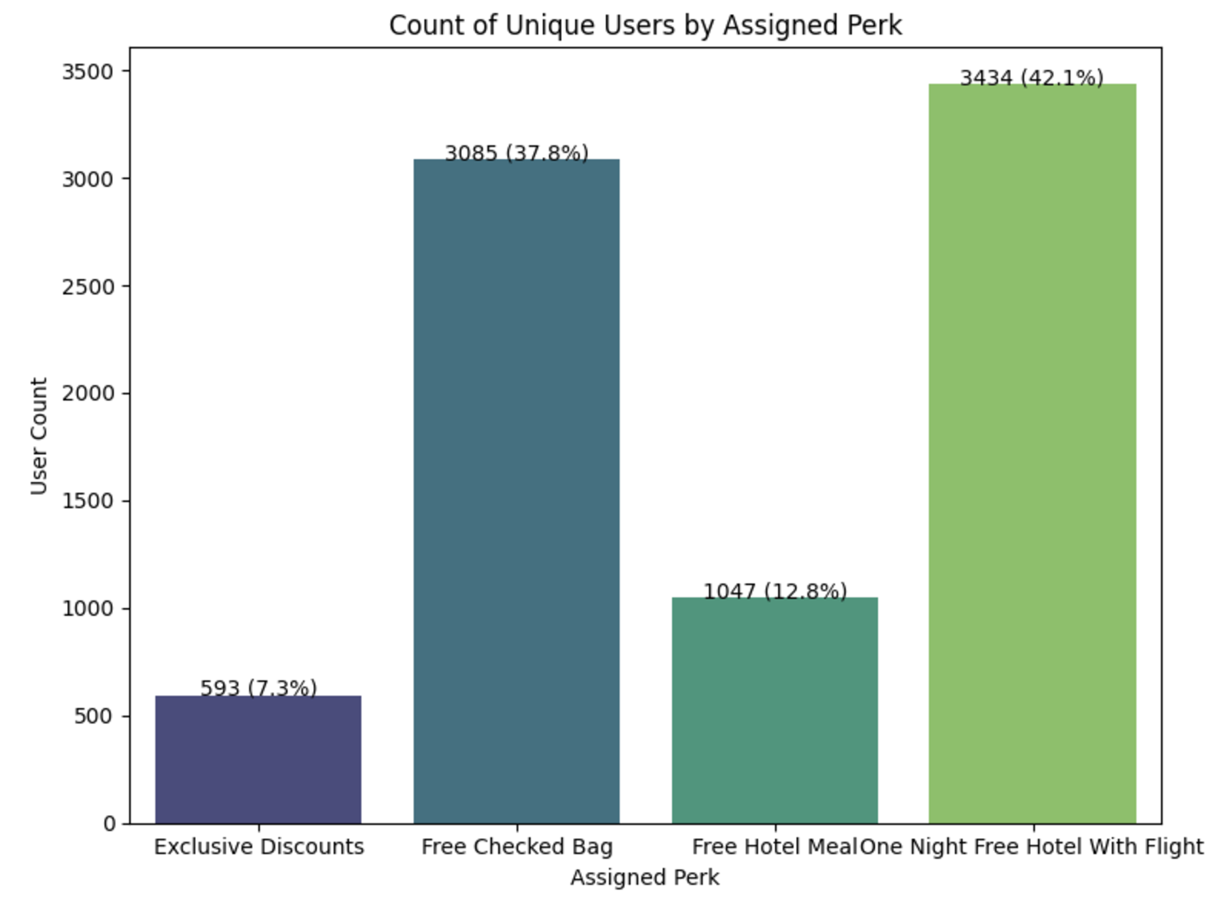
Assignment of Perks per User

Slide 18
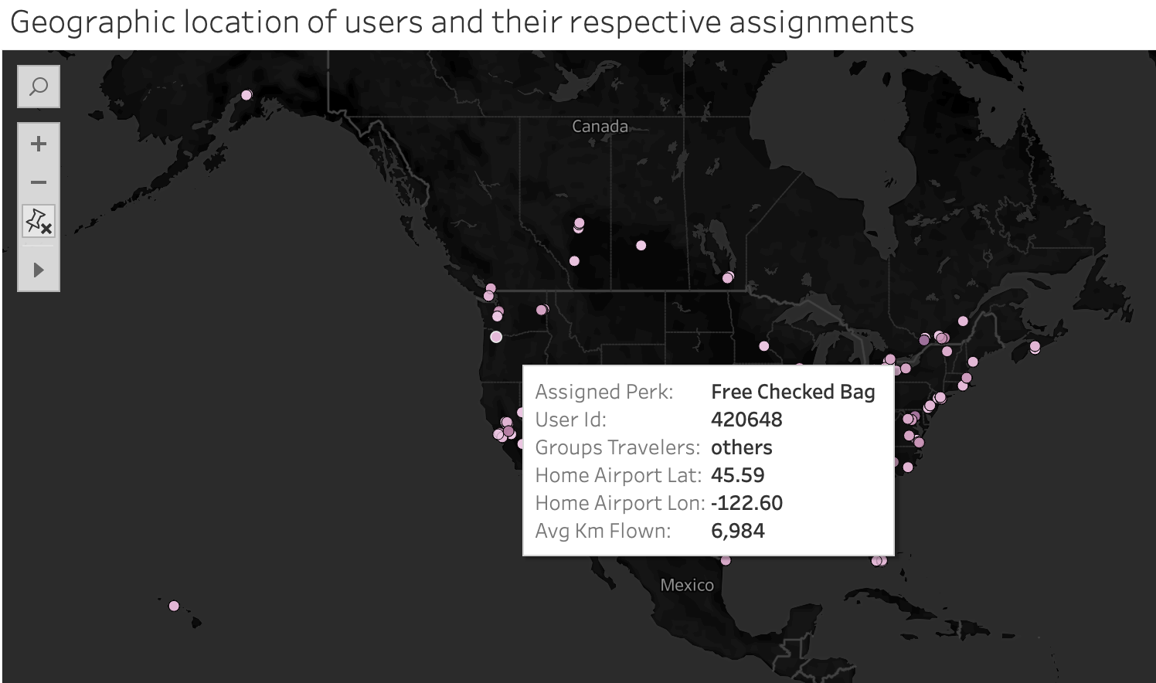
Demographic insights after Segmenting

Slide 19
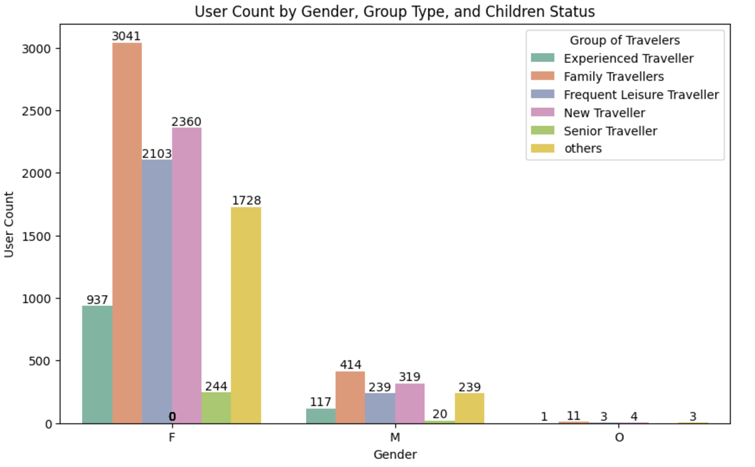

Family Travelers

Slide 20
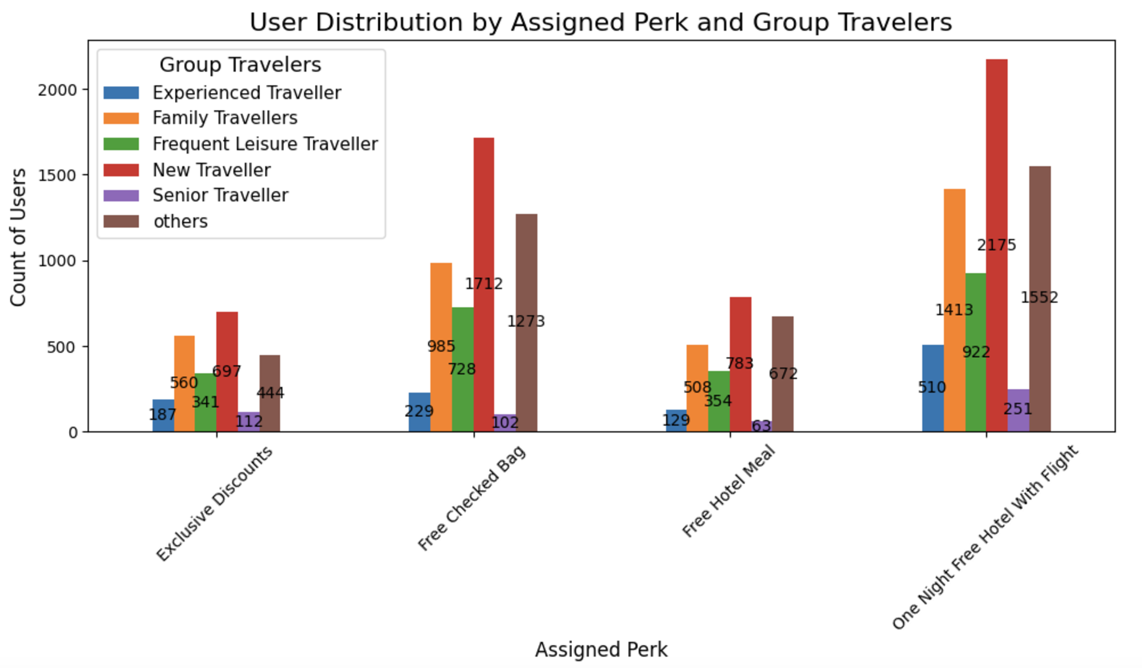

Perks by Groups Travelers

Slide 21
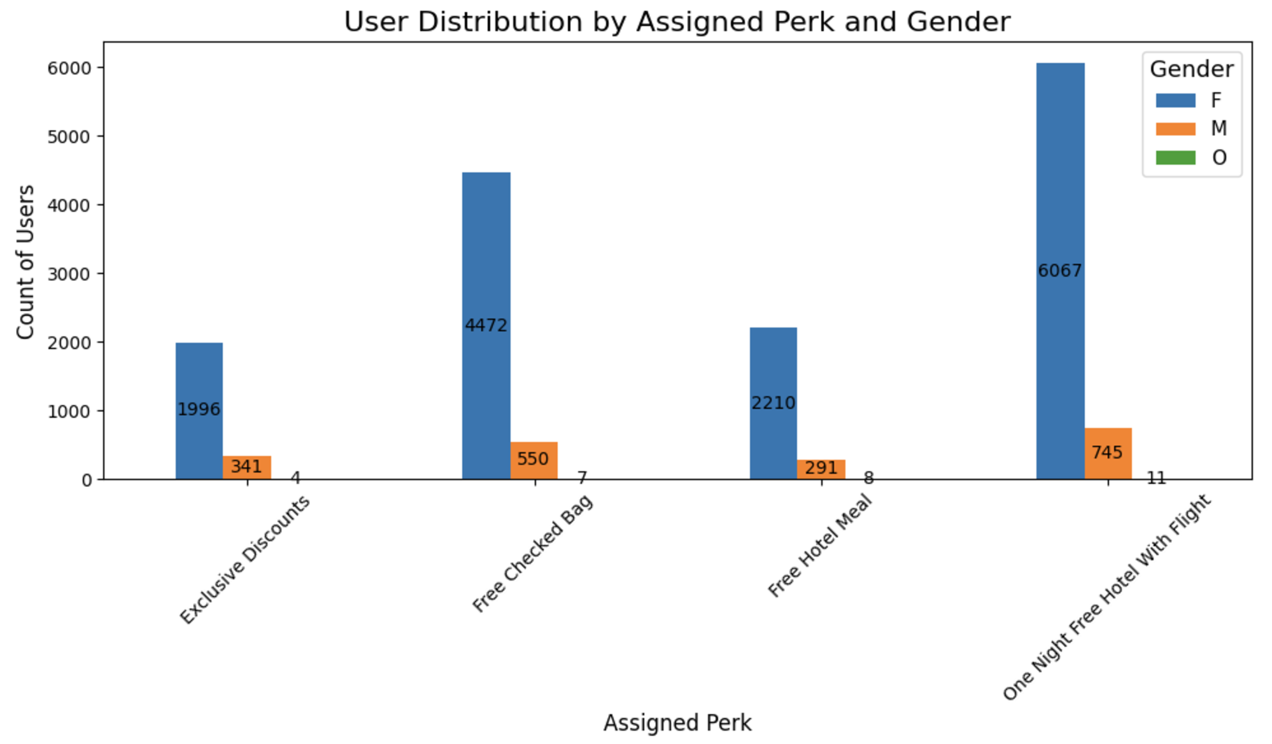

Perks assigned to user by gender

Slide 22
Recommendations
Tiered Rewards Program: Develop a multi-level rewards system that caters to different stages of customer engagement, leveraging overlapping preferences to encourage more bookings.
Perk Consolidation: Consider merging similar perks, such as the “Free Hotel Meal” and “One Night Free Hotel with Flight,” to streamline the offerings.
Regular Segmentation Updates: Re-assess customer segments periodically with larger datasets to ensure more accurate and detailed segmentation, enabling better-targeted strategies as customer preferences evolve.
Customer Feedback: Implement a feedback system to gather insights from customers, helping to refine the rewards program and maintain its relevance.

Slide 23
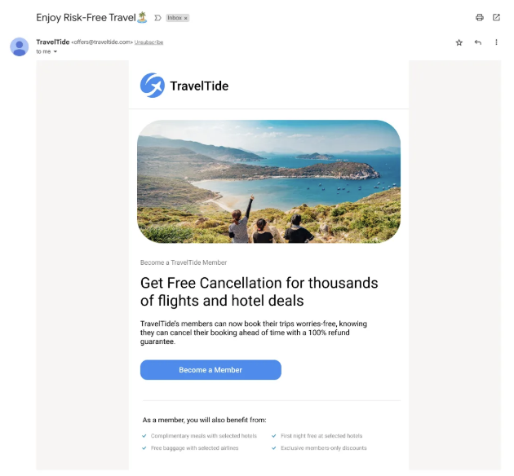

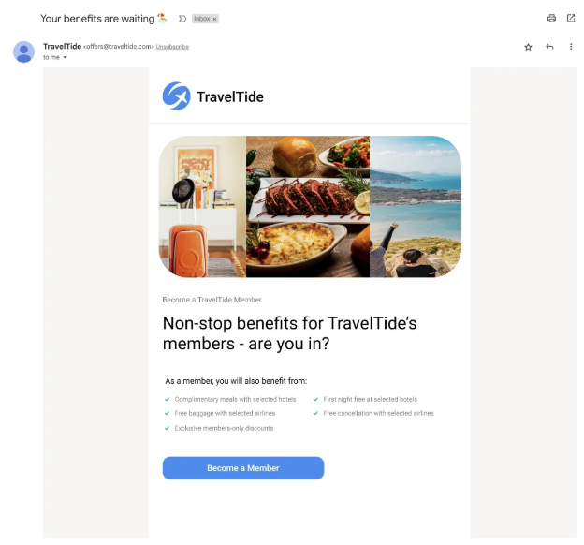
Recommendations
Personalized Marketing: Tailor marketing efforts to each customer segment, ensuring that messages and benefits resonate with their specific preferences to drive higher engagement and loyalty.
Gender Diversity: Focus on addressing gender imbalances in the customer base, ensuring a more inclusive rewards program. We could also incentivize referrals by offering extra points for referring male customers, in addition to regular points for any referral.
Family-Friendly Perks: Offer flexible check-in and check-out times for families with children to provide greater convenience. Additionally, introduce family-specific benefits like “Kids Stay Free” or Family Meal Packages at hotels, designed to appeal to women traveling with children.
Solo Traveler Incentives: Implement a points-based rewards system where customers earn points for activities such as bookings, sharing feedback, and referring others. These points can be redeemed for future rewards, providing additional incentives for solo travelers.

